Slide 1
Classification &Prediction
Vijayalakshmi Anand

Slide 2
Classification and Prediction
What is Classification
Classification vs Prediction
Decision trees for classification
Examples of Decision trees
Attribute splitting techniques
Challenges of classification

Slide 3
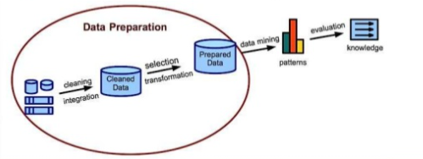
Data mining process

Slide 4


What is classification?
Classification is the task of assigning objects to one of the predefined categories
Following are some of the examples of classification tasks
Predicting tumor cells as benign or malignant
Classifying credit card transactions as legitimate or fraudulent

Slide 5

Categorizing news stories as finance, weather, entertainment, sports, etc

Slide 6

Contd..
Detecting spam email messages based upon the message header and contents

Slide 7
Classification: Definition
Given a collection of records (training set )
Each record contains a set of attributes, one of the attributes is the class.
Find a model for class attribute as a function of the values of other attributes.
Goal: previously unseen records should be assigned a class as accurately as possible.
A test set is used to determine the accuracy of the model.
Notes:
Usually, the given data set is divided into training and test sets, with training set used to build the model and test set used to validate it.

Slide 8
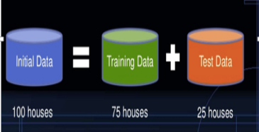
What is Training data and Test data

Slide 9
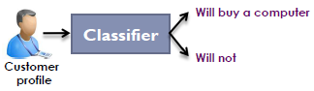
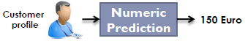
Classification vs Prediction
Classification
Prediction
Predicts categorical class labels
Use labels of the training data to classify new data
Example
A model or classifier is constructed
to predict categorical labels such as
“safe” or “risky” for a loan
application data.
Models continuous-valued functions, i.e.,
predicts unknown or missing values
Example
A marketing manager would like to predict how much a given costumer will spend during a sale
Unlike classification, it provides ordered Values
Regression analysis is used for
Prediction
Prediction is a short name for numeric
prediction

Slide 10
Supervised vs. Unsupervised Learning
Supervised learning (classification)
Supervision: The training data (observations, measurements, etc.) are accompanied by labels indicating the class of the observations
New data is classified based on the training set
Unsupervised learning (clustering)
The class labels of training data is unknown
Given a set of measurements, observations, etc. with the aim of establishing the existence of classes or clusters in the data

Slide 11
Classification—A Two-Step Process
Model construction: describing a set of predetermined classes
Each tuple/sample is assumed to belong to a predefined class, as determined by the class label attribute
The set of tuples and their associated class labels, used for model construction is training set
The model is represented as classification rules, decision trees, or mathematical formulae

Slide 12
Model usage:
for classifying future or unknown objects
Estimate accuracy of the model
The known label of test sample is compared with the classified result from the model
Accuracy rate is the percentage of test set samples that are correctly classified by the model
Test set is independent of training set (otherwise overfitting)
If the accuracy is acceptable, use the model to classify new data
Note: If the test set is used to select models, it is called validation (test) set

Slide 13
Process (1): Model Construction
Classification
Algorithms
Training
Data
Classifier
(Model)
IF rank = ‘professor’
OR years > 6
THEN tenured = ‘yes’

Slide 14
Process (2): Using the Model in Prediction
Classifier
Testing
Data
Unseen Data
(Jeff, Professor, 4)
Tenured?

Slide 15
Lazy vs. Eager Learning
Lazy vs. eager learning
Lazy learning (e.g., instance-based learning): Simply stores training data (or only minor processing) and waits until it is given a test tuple
Eager learning (the above discussed methods): Given a set of training set, constructs a classification model before receiving new (e.g., test) data to classify
Lazy: less time in training but more time in predicting

Slide 16
Lazy Learner: Instance-Based Methods
Instance-based learning:
Store training examples and delay the processing (“lazy evaluation”) until a new instance must be classified
Typical approaches
K-Nearest neighbors
Case based reasoning

Slide 17
Evaluating Classification Methods
Accuracy
classifier accuracy: predicting class label
predictor accuracy: guessing value of predicted attributes
Speed
time to construct the model (training time)
time to use the model (classification/prediction time)
Robustness: handling noise and missing values
Scalability: efficiency in disk-resident databases
Interpretability
understanding and insight provided by the model
Other measures, e.g., goodness of rules

Slide 18
Classification Techniques
Decision Tree based Methods
Rule-based Methods
Neural Networks
computational networks that simulate the decision process in neurons (networks of nerve cell)
Naïve Bayes and Bayesian Belief Networks
uses the probability theory to find the most likely of the possible classifications
Support Vector Machines
fits a boundary to a region of points that are all alike; uses the boundary to classify a new point

Slide 19
Decision tree classification Method

Slide 20
Decision tree
Decision tree is a flowchart-like tree structure,
internal node (denoted by rectangles) denotes a test on an attribute,
each branch represents an outcome of the test, and
each leaf node (or terminal node, denoted by ovals ) holds a class label. It represents the concept buys computer, that is, it predicts whether a customer at
Used for classification.
Easily converted to classification rules.
Does not require any domain knowledge.
Decision tree algorithms: ID3(Iterative Dichotomiser), C4.5 (successor of ID3), CART(classification and regression trees).

Slide 21
Example of a Decision Tree
categorical
categorical
continuous
Splitting Attributes
class
Refund
Yes
No
NO
MarSt
Single, Divorced
Married
TaxInc
NO
< 80K
> 80K
NO
YES
Training Data
Model: Decision Tree

Slide 22
Another Example of Decision Tree
categorical
categorical
continuous
class
MarSt
Single, Divorced
Married
NO
Refund
Yes
No
NO
TaxInc
< 80K
> 80K
NO
YES
There could be more than one tree that fits the same data!

Slide 23
Apply Model to Test Data
Start from the root of tree.
Test Data
Refund
Yes
No
NO
MarSt
Single, Divorced
Married
TaxInc
NO
< 80K
> 80K
NO
YES

Slide 24
Apply Model to Test Data
Test Data
Refund
Yes
No
NO
MarSt
Single, Divorced
Married
TaxInc
NO
< 80K
> 80K
NO
YES

Slide 25
Apply Model to Test Data
Test Data
Refund
Yes
No
NO
MarSt
Single, Divorced
Married
TaxInc
NO
< 80K
> 80K
NO
YES

Slide 26
Apply Model to Test Data
Test Data
Refund
Yes
No
NO
MarSt
Single, Divorced
Married
TaxInc
NO
< 80K
> 80K
NO
YES

Slide 27
Apply Model to Test Data
Test Data
Refund
Yes
No
NO
MarSt
Single, Divorced
Married
TaxInc
NO
< 80K
> 80K
NO
YES

Slide 28
Apply Model to Test Data
Test Data
Refund
Yes
No
NO
MarSt
Single, Divorced
Married
Assign Cheat to “No”
TaxInc
NO
< 80K
> 80K
NO
YES

Slide 29
Tree Induction
Greedy strategy.
Split the records based on an attribute test that optimizes certain criterion.
Issues
Determine how to split the records
How to specify the attribute test condition?
How to determine the best split?
Determine when to stop splitting

Slide 30
How to Specify Test Condition?
Depends on attribute types
Nominal
Ordinal
Continuous
Depends on number of ways to split
2-way split
Multi-way split

Slide 31
Method for expressing attribute test condition for all type of attributes

Slide 32
Splitting Based on Nominal Attributes
Multi-way split: Use as many partitions as distinct values.
Binary split: Divides values into two subsets. Need to find optimal partitioning.
CarType
Family
Luxury
Sports
OR
CarType
CarType
{Sports, Luxury}
{Family, Luxury}
{Family}
{Sports}

Slide 33
Splitting Based on Ordinal Attributes
Multi-way split: Use as many partitions as distinct values.
Binary split: Divides values into two subsets. Need to find optimal partitioning.
Size
Small
Large
Medium
Size
OR
Size
{Small, Medium}
{Medium, Large}
{Large}
{Small}
Size
{Small, Large}
{Medium}

Slide 34
Splitting Based on Continuous Attributes
Different ways of handling
Discretization to form an ordinal categorical attribute
Static – discretize once at the beginning
Dynamic – ranges can be found by equal interval bucketing, equal frequency bucketing (percentiles), or clustering.
Binary Decision: (A < v) or (A ≥ v)
consider all possible splits and finds the best cut
can be more compute intensive

Slide 35
Splitting Based on Continuous Attributes

Slide 36
How to determine the Best Split
Before Splitting: 10 records of class 0, 10 records of class 1
Which test condition is the best?

Slide 37
How to determine the Best Split
Greedy approach:
Nodes with homogeneous class distribution are preferred
Need a measure of node impurity:
Non-homogeneous,
High degree of impurity
Homogeneous,
Low degree of impurity

Slide 38
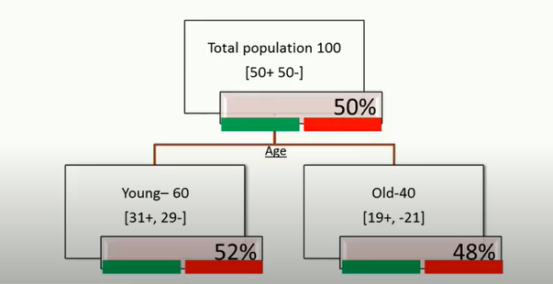
Example

Slide 39
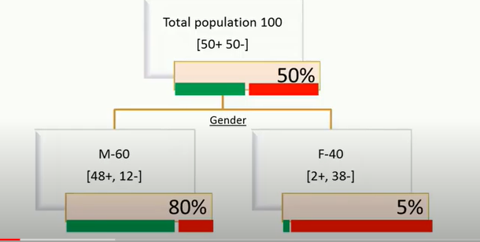
Contd..

Slide 40
Measure of Node Impurity

Slide 41
Measures of Node Impurity
Entropy (Information Gain)
Gini Index

Slide 42
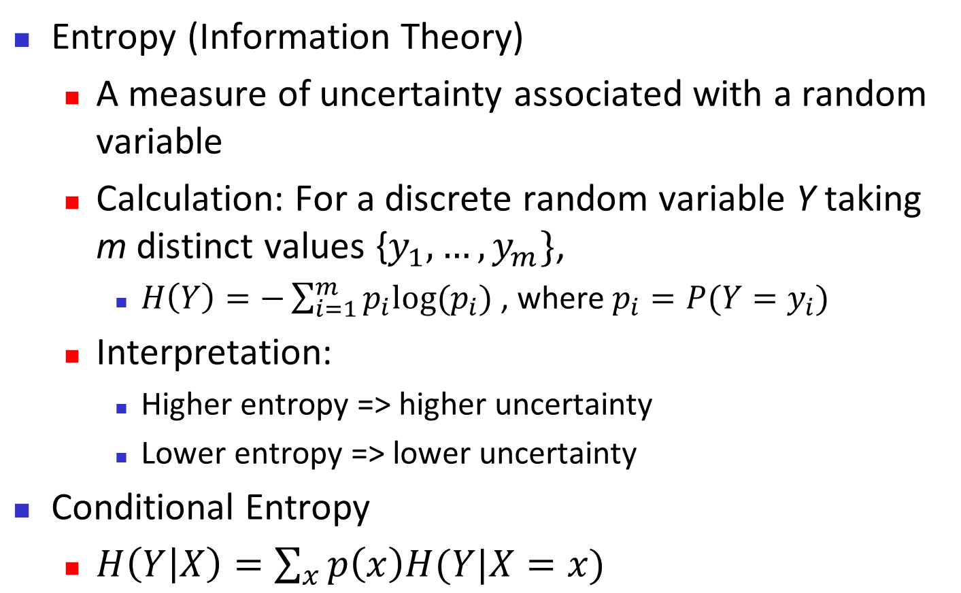
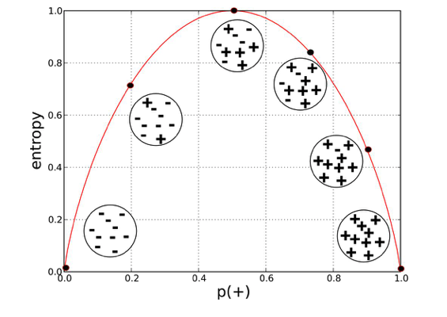
Brief Review of Entropy
m = 2

Slide 43
Attribute Selection Measure: Information Gain (ID3/C4.5)
Select the attribute with the highest information gain
Let p_{i} be the probability that a tuple in D belongs to class C_{i}, estimated by |C_{i, D}|/|D|, m is the number of distinct classes, v is the number of distinct values in an attribute.
Expected information (entropy) needed to classify a tuple in D:
Information needed (after using A to split D into v partitions) to classify D
The smaller the expected information required, greater the purity of the partitions.

Slide 44
Attribute Selection Measure: Information Gain (ID3/C4.5)
Information gained by branching on attribute A
Defined as the difference between the original information requirement (i.e. based on just the proportion of the classes) and the new requirement (i.e. obtained after partitioning of attribute A).
Attribute with highest information gain Gain(A), is chosen as the splitting attribute at node N.
Notes:
I : the expected information needed to classify a given sample
E (entropy) : expected information based on the partitioning into subsets by A

Slide 45
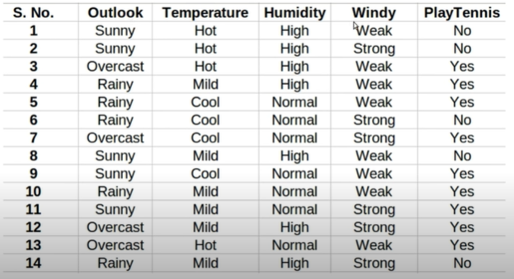
Example-Predict tennis will be played or not

Slide 46
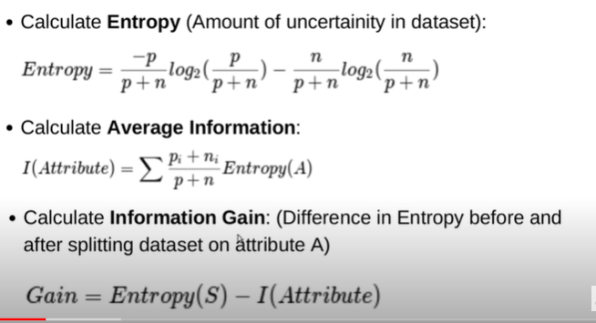
Contd..

Slide 47
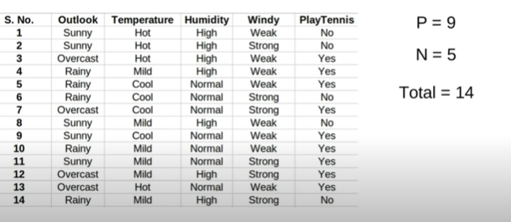
Contd..

Slide 48
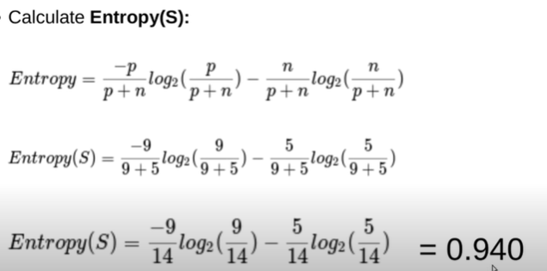
Contd..

Slide 49
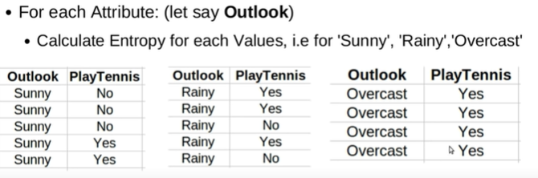
Cond..

Slide 50
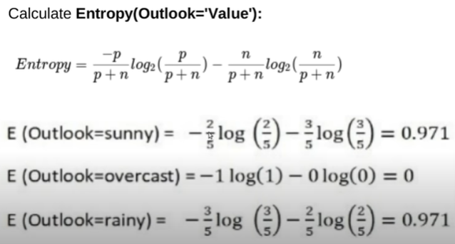
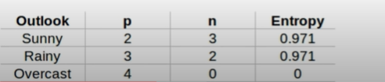
Contd..

Slide 51
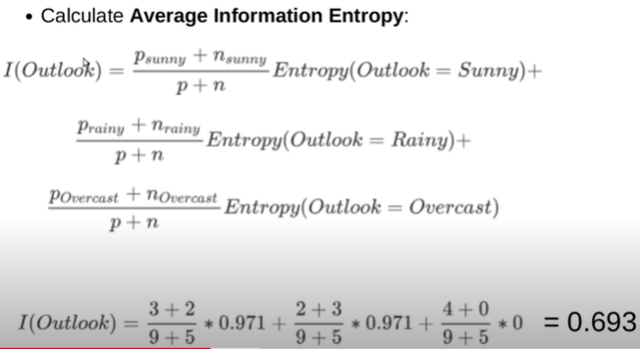
Contd..

Slide 52
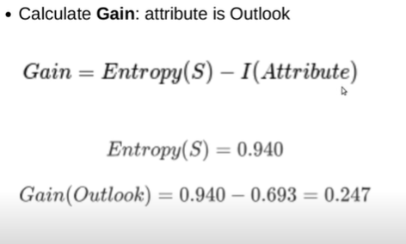
Contd..

Slide 53
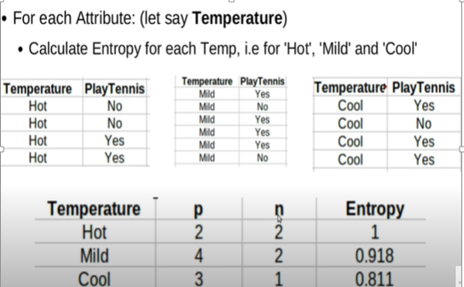
Contd..

Slide 54
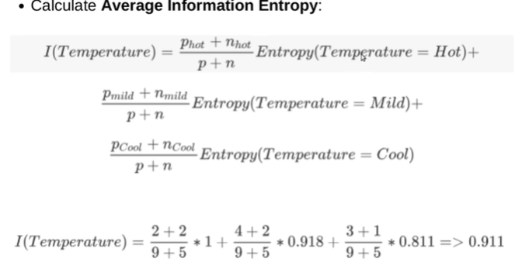
Contd..

Slide 55
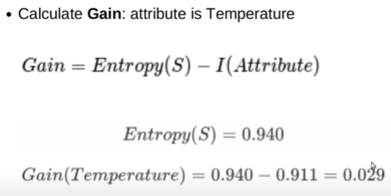
Contd..

Slide 56
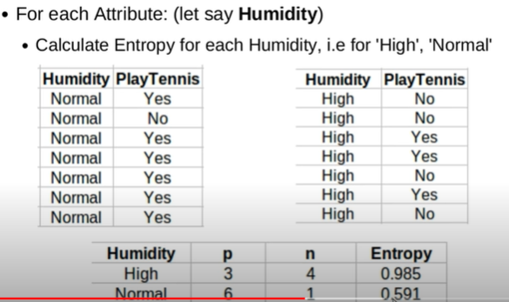
Contd..

Slide 57
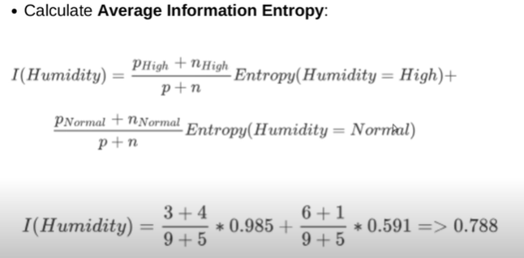
Contd..

Slide 58
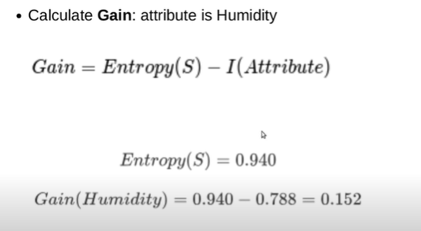
Contd..

Slide 59
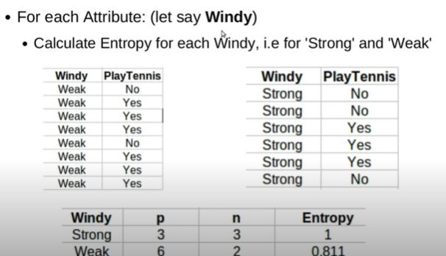
Contd..

Slide 60
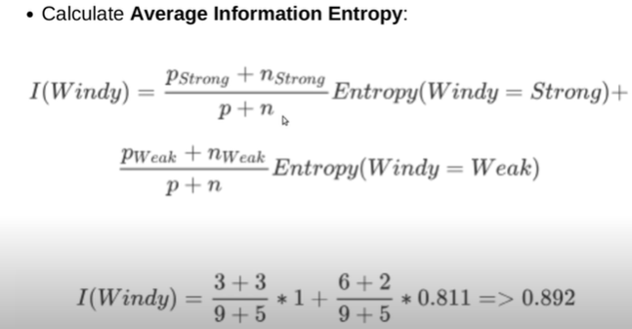
Contd..

Slide 61
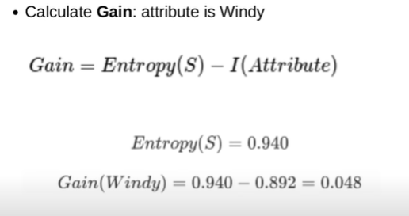
Contd..

Slide 62
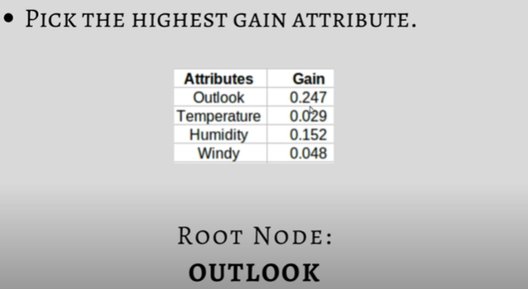
Contd..

Slide 63
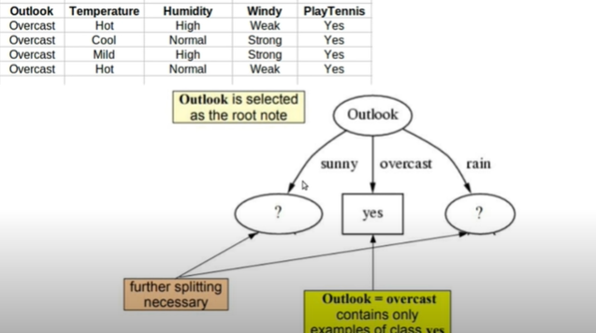
Contd..

Slide 64
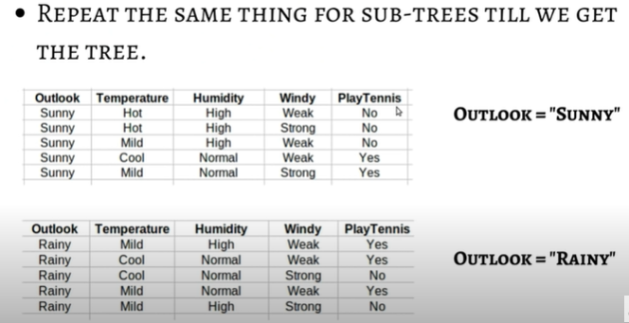
Contd..

Slide 65
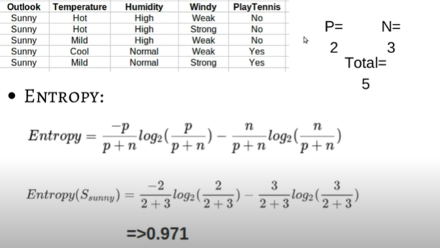
Contd..

Slide 66
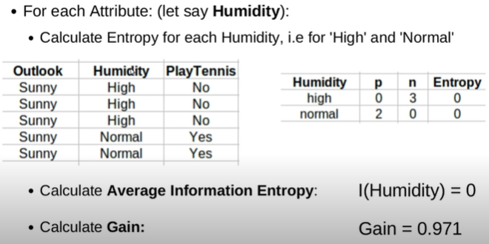
Contd..

Slide 67
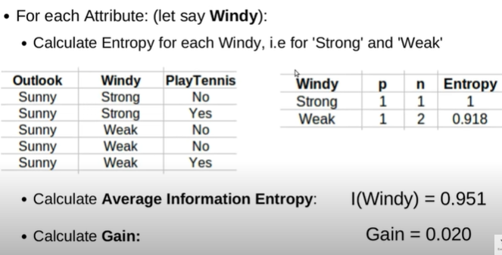
Contd..

Slide 68
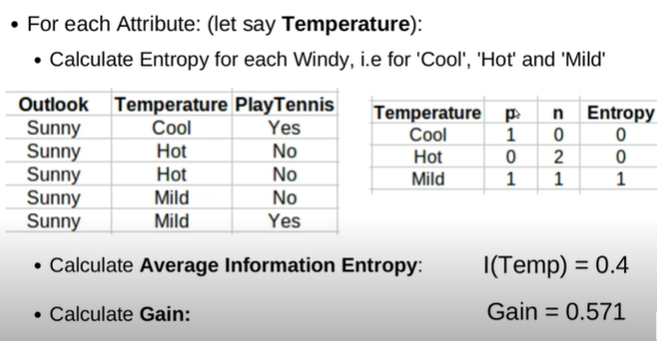
Contd..

Slide 69
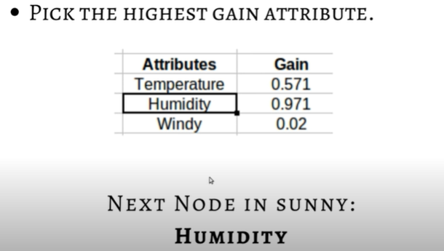
Contd..

Slide 70
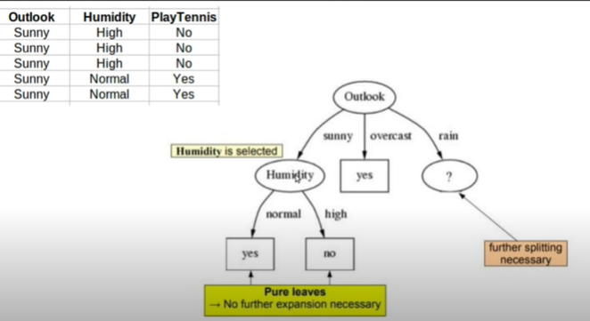
Contd..

Slide 71
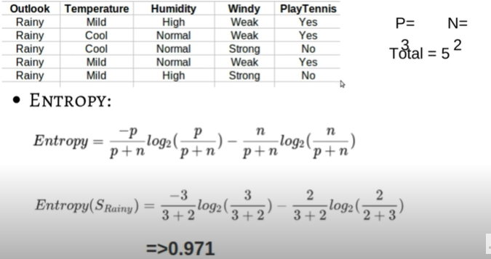
Contd..

Slide 72
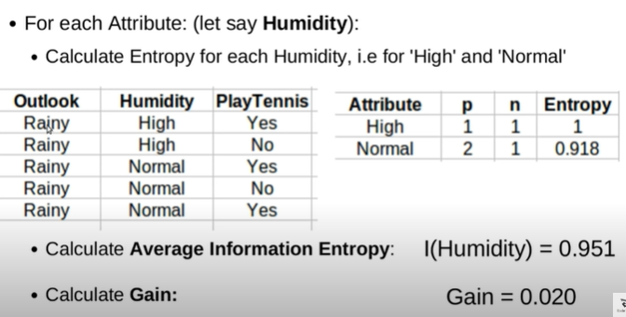
Contd..

Slide 73
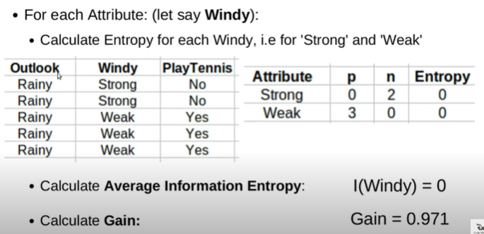
Contd..

Slide 74
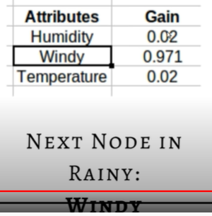
Contd..

Slide 75
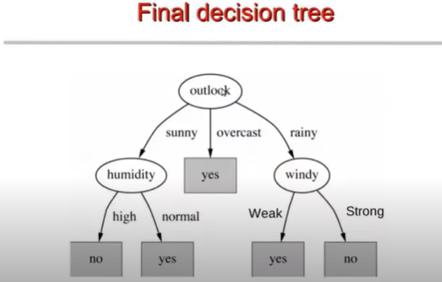
Contd..

Slide 76
Attribute Selection: Information Gain
Class P: buys_computer = “yes”
Class N: buys_computer = “no”

Slide 77
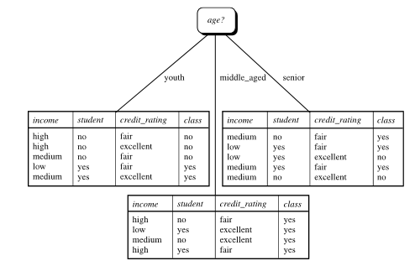
Attribute Selection: Information Gain

Slide 78
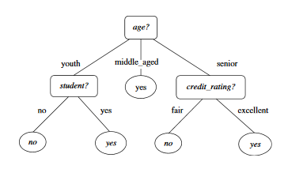
Decision Tree
Decision tree for the concept “buys_computer”

Slide 79
Splitting Based on Continuous Attributes
Different ways of handling
Discretization to form an ordinal categorical attribute
Static – discretize once at the beginning
Dynamic – ranges can be found by equal interval bucketing, equal frequency bucketing(percentiles), or clustering.
Binary Decision: (A < v) or (A ≥ v)
consider all possible splits and finds the best cut
can be more compute intensive

Slide 80
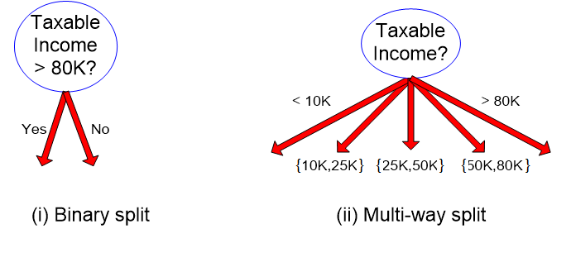
Splitting Based on Continuous Attributes

Slide 81
Computing Information-Gain for Continuous-Valued Attributes
Let attribute A be a continuous-valued attribute
Must determine the best split point for A
1.Sort the value A in increasing order
2.Typically, the midpoint between each pair of adjacent values is considered as a possible split point
(a_{i}+a_{i+1})/2 is the midpoint between the values of a_{i} and a_{i+1}
3.The point with the minimum expected information requirement for A is selected as the split-point for A
Split:
D1 is the set of tuples in D satisfying A ≤ split-point, and D2 is the set of tuples in D satisfying A > split-point

Slide 82
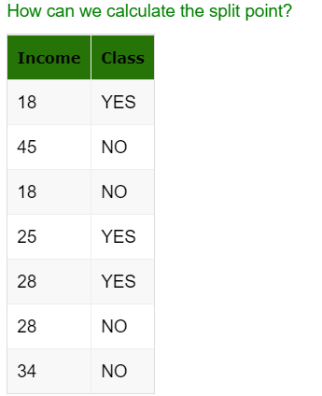
Example

Slide 83
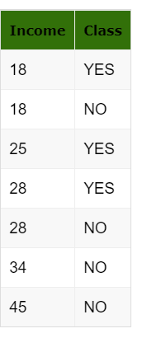
Contd..
Step 1:
First of all, we need to sort the data in ascending order. After sorting the data, data is shown in the table below.

Slide 84
Step 2:
Find the midpoint of first two numbers and calculate the information gain
Split point = (18+25) / 2 = 21
Info income<21(D) = 2/7(I(1,1)) + 5/7(I(2,3))
= 2/7(-1/2(log2(1/2)) – 1/2(log2(1/2))+5/7(-2/5(log2(2/5)) – 3/5(log2(3/5)))
= 0.98

Slide 85
Example2
Compute the information gain for every possible split, for the given continuous valued attribute?
Sort the values and find the the midpoint between each
pair of adjacent values (split_point).
Calculate Info(D)
Calculate the entropy for each split_point for “<=” and “>”
Find Gain for each split_point
A1 | A2 | Class
T | 1 | +
T | 6 | +
T | 5 | -
F | 4 | +
F | 7 | -
F | 3 | -
F | 8 | -
T | 7 | +
F | 5 | -
Class | + | - | + | - | + | - | -
Sorted A2 | 1 | 3 | 4 | 5 | 6 | 7 | 8
Split_Point |  | 2 | 3.5 | 4.5 | 5.5 | 6.5 | 7.5

Slide 86
Gain Ratio for Attribute Selection (C4.5)
Information gain measure is biased towards attributes with a large number of distinct values. Eg. Product_ID (unique for every tuple), resulting in large number of partitions as Info_{product_ID} (D) = 0, Such partitioning is useless.
C4.5 (a successor of ID3) uses gain ratio to overcome the problem.
It applies normalization to information gain using a “split information”
GainRatio(A) = Gain(A)/SplitInfo_{A} (D)
Ex. Gain Ratio of “income” on the given data set.
gain_ratio(income) = 0.029/1.557 = 0.019
The attribute with the maximum gain ratio is selected as the splitting attribute

Slide 87
Measure of Impurity: GINI
Used in CART, SLIQ, SPRINT.
Gini Index for a given node t :
(NOTE: p( j | t) is the relative frequency of class j at node t).
It considers binary-split for each attribute
If a data set D is split on A (such that A∈ S_{A}?) into two subsets D₁ and D₂, the gini index gini(D) is defined as
Maximum -when records are equally distributed among all classes, implying least interesting information
Minimum -when all records belong to one class, implying most interesting information

Slide 88
Examples for computing GINI
P(C1) = 0/6 = 0 P(C2) = 6/6 = 1
Gini = 1 – P(C1)² – P(C2)² = 1 – 0 – 1 = 0
P(C1) = 1/6 P(C2) = 5/6
Gini = 1 – (1/6)² – (5/6)² = 0.278
P(C1) = 2/6 P(C2) = 4/6
Gini = 1 – (2/6)² – (4/6)² = 0.444

Slide 89
Example
Splits into two partitions
Effect of Weighing partitions:
Larger and Purer Partitions are sought for.
B?
Yes
No
Gini(N1) = 1 – (5/7)² – (2/7)² = 0.278
Gini(N2) = 1 – (1/5)² – (4/5)² = 0.32
Node N1
Node N2
Gini(Children) = 7/12 * 0.278 + 5/12 * 0.32 = 0.295

Slide 90
Categorical Attributes: Computing Gini Index
For each distinct value, gather counts for each class in the dataset
Use the count matrix to make decisions
Multi-way split
Two-way split
(find best partition of values)

Slide 91
Continuous Attributes: Computing Gini Index
Use Binary Decisions based on one value
Several Choices for the splitting value
Number of possible splitting values = Number of distinct values
Each splitting value has a count matrix associated with it
Class counts in each of the partitions, A < v and A ≥ v
Simple method to choose best v
For each v, scan the database to gather count matrix and compute its Gini index
Computationally Inefficient! Repetition of work.

Slide 92
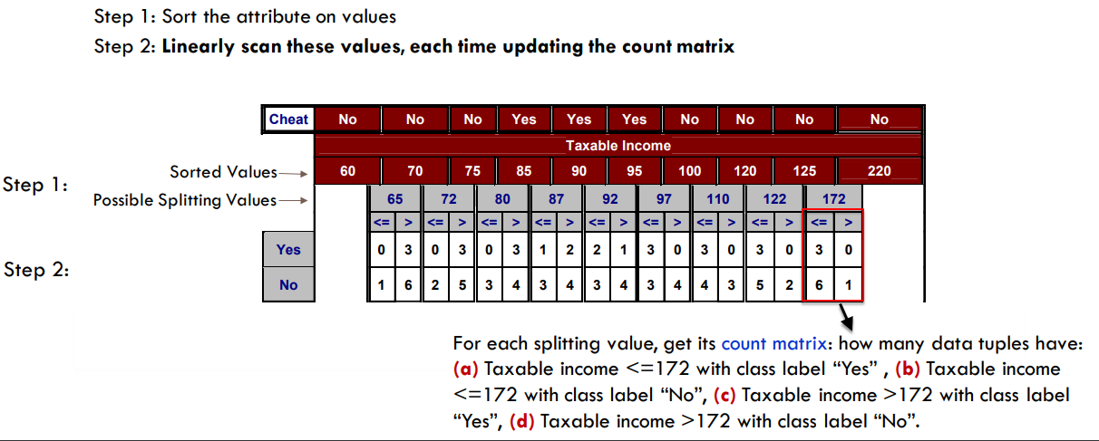
Continuous Attributes: Computing Gini Index...

Slide 93
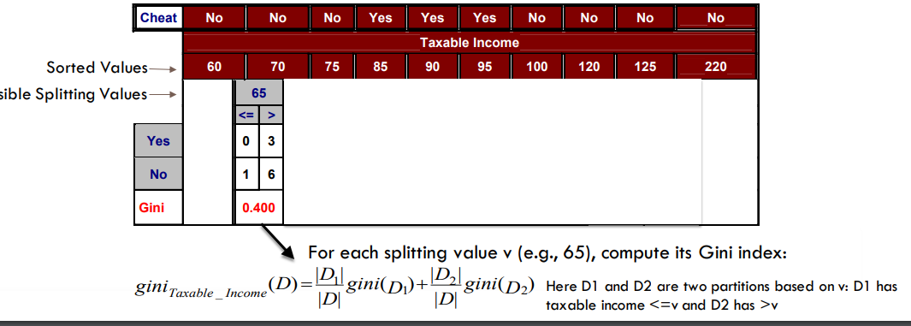

Slide 94
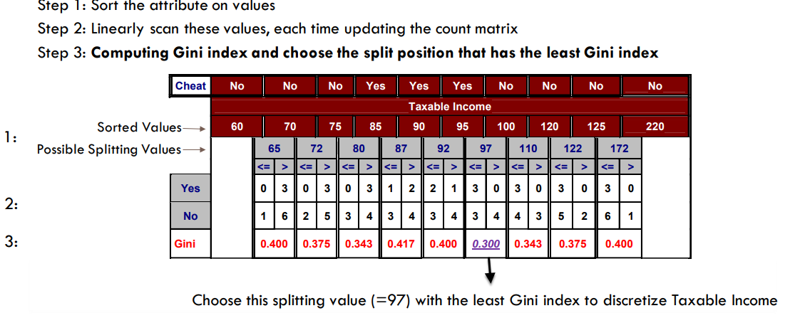

Slide 95
Comparing Attribute Selection Measures
The three measures, in general, return good results but
Information gain:
biased towards multivalued attributes
Gain ratio:
tends to prefer unbalanced splits in which one partition is much smaller than the others
Gini index:
multivalued attributes
has difficulty when # of classes is large

Slide 96
Decision Tree Based Classification
Advantages:
Inexpensive to construct
Extremely fast at classifying unknown records
Easy to interpret for small-sized trees
Accuracy is comparable to other classification techniques for many simple data sets

Slide 97
Underfitting vs. Overfitting
Underfitting results in decision trees that are too simple to solve the problem. They may offer superior interpretability.
Overfitting results in decision trees that are more complex than necessary
Training error no longer provides a good estimate of how well the tree will perform on previously unseen records
Need new ways for estimating errors

Slide 98
How to Address Overfitting
Pre-Pruning (Early Stopping Rule)
Stop the algorithm before it becomes a fully-grown tree
General stopping conditions for a node:
Stop if all instances belong to the same class
Stop if all the attribute values are the same
More restrictive conditions (for pre-pruning) :
Stop if number of instances is less than some user-specified threshold
Stop if class distribution of instances are independent of the available features (e.g., using χ 2 test)
Stop if expanding the current node does not improve impurity measures (e.g., Gini or information gain).

Slide 99
How to Address Overfitting…
Post-pruning
Grow decision tree to its entirety
Trim the nodes of the decision tree in a bottom-up fashion
If generalization error(i.e. expected error of the model on previously unseen records) improves after trimming, replace sub-tree by a leaf node.
Class label of leaf node is determined from majority class of instances in the sub-tree

Slide 100
Thank you ☺
Q&A
Suggestions / Feedback

